Slide 1


OAuth 2.1
The Next Level of Authorization

Slide 2

Agenda
History
OAuth 2.0 Basics
Open ID Connect Basics
Changes in OAuth 2.1
Backend-For-Frontend
Demo
Takeaways
2
Notes:
Afbeelding aanpassen:
Klik met je rechtermuisknop in de linker bovenhoek van de afbeelding.
Selecteer ‘Change picture’
Selecteer ‘From file’
Zoek de afbeelding die je op de slide wilt hebben en druk op ‘Insert’.

Slide 3

HISTORY
The journey to OAuth
Notes:
Raster verplaatsen Bovenop het fotovak staat een raster, dat je naar wens mag verplaatsen, zodat het gat goed uitkomt op de foto. Klik 1 keer op het raster, verplaats het dan met de pijltjes toetsen.

Slide 4
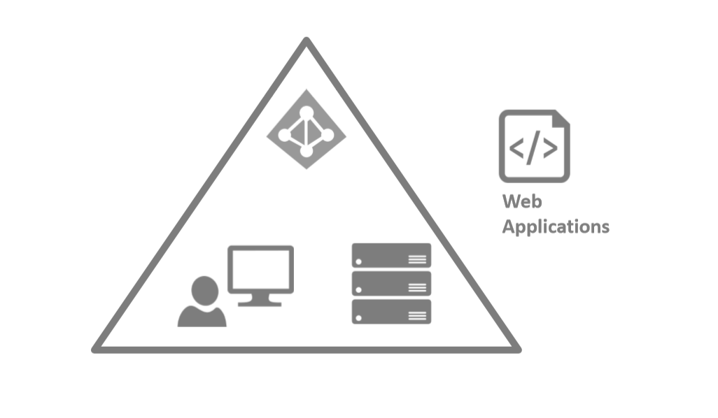
In the beginning …

Slide 5

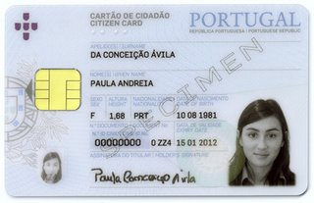


Identification in Real Life
Externalizes
Authentication
3. Obtain Id
1. Registrate
2.Prove Your Identity?
“Paula”
Gets user info from the document

Slide 6
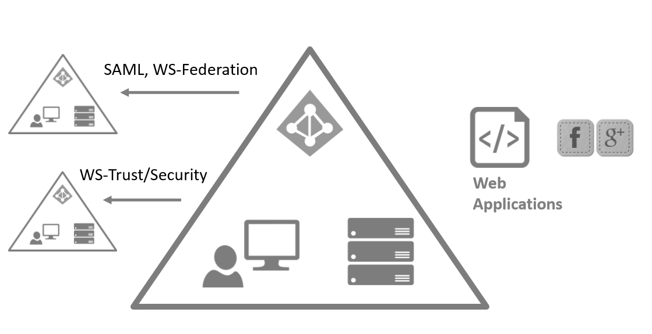
...then came Federation

Slide 7




Claims Can Set Your Application Free
Identity Provider
STS
Claims
Relying Party
Security Token

Slide 8
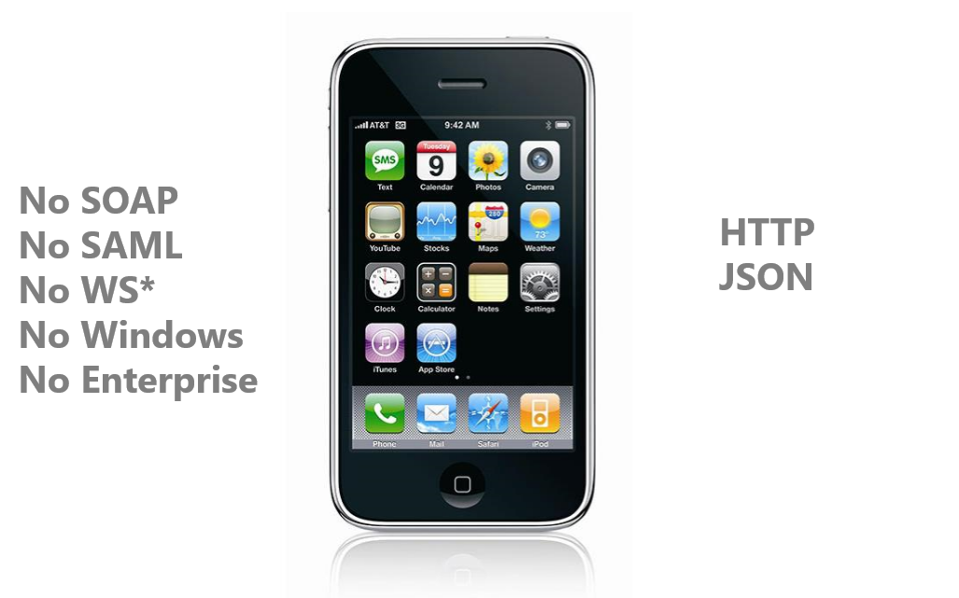
Then this happened...

Slide 9
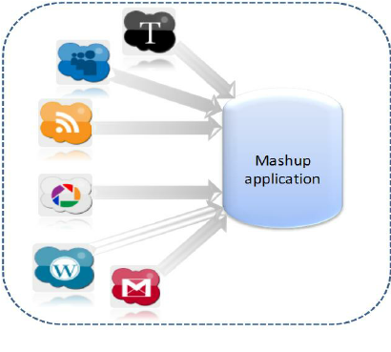
Then this happened...

Slide 10
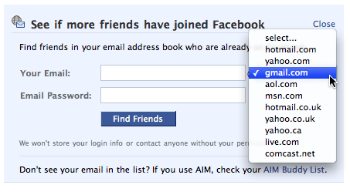
Password Sharing Anti-Pattern

Slide 11
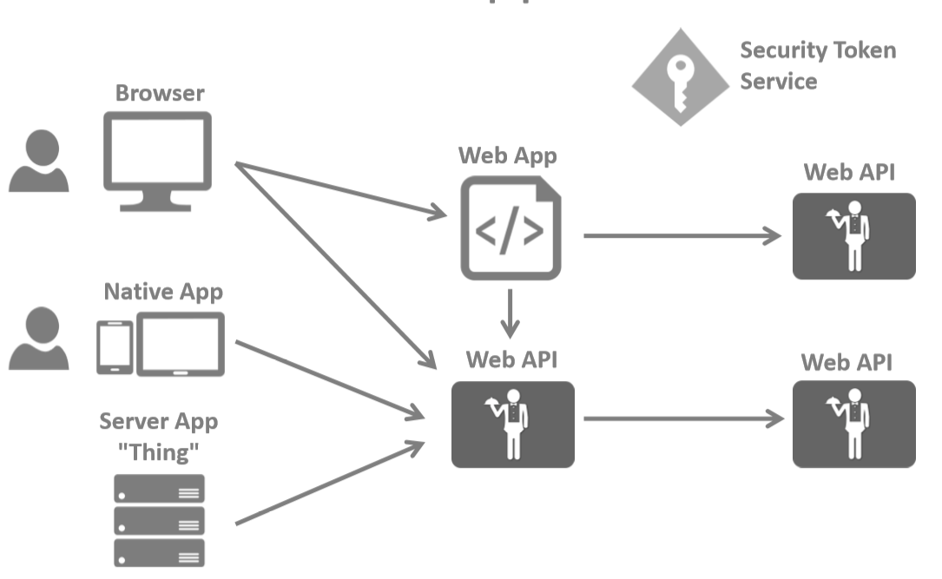
Modern Applications

Slide 12
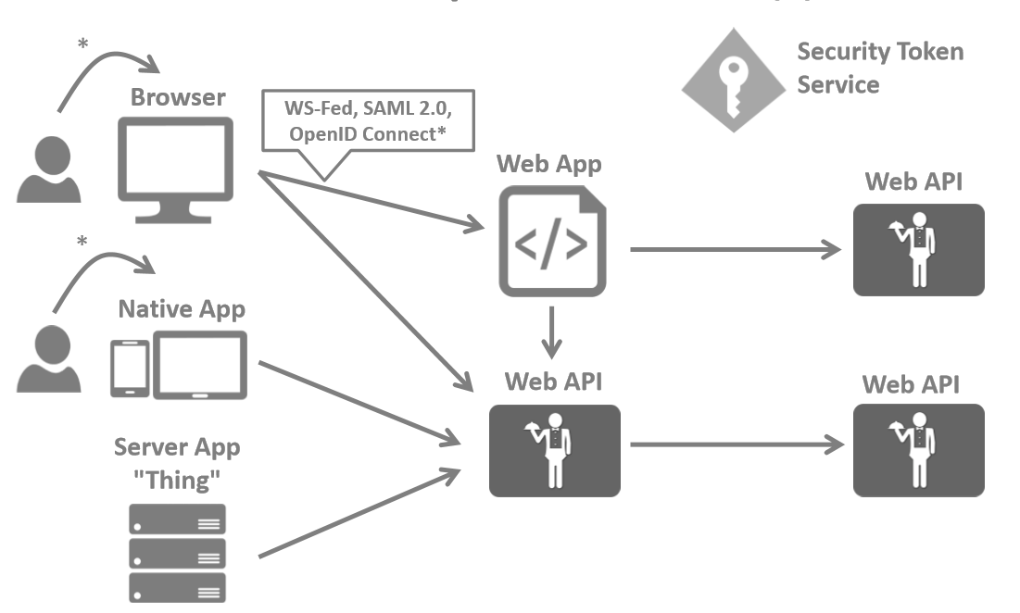
Security Protocols(I)

Slide 13
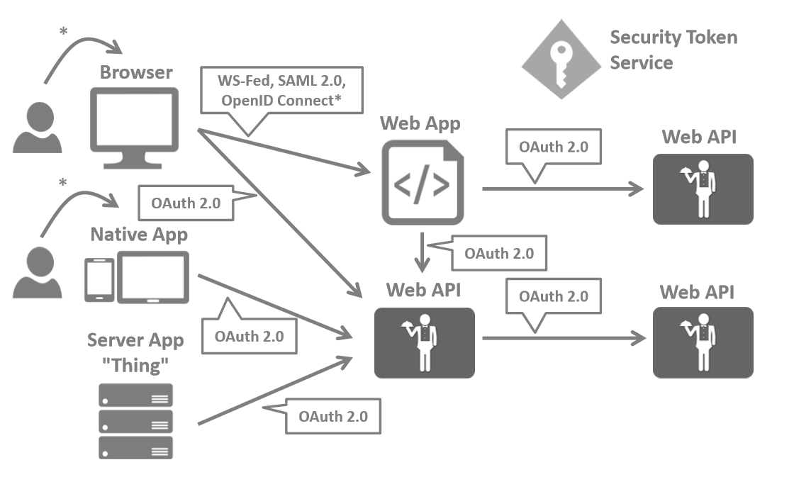
Security Protocols(II)

Slide 14
Oauth 2.0
The Basics
Notes:
Raster verplaatsen Bovenop het fotovak staat een raster, dat je naar wens mag verplaatsen, zodat het gat goed uitkomt op de foto. Klik 1 keer op het raster, verplaats het dan met de pijltjes toetsen.

Slide 15

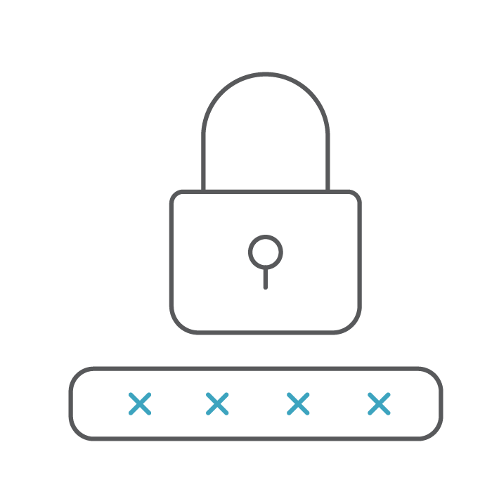


ROLES in Oauth 2.0
The Resource Owner:
The user who wants to share their protected resources with a client application.
The Authorization Server:
The server that is responsible for issuing access tokens to the client after the resource owner has granted access.
The Client:
The application that wants to access the protected resources on behalf of the resource owner.
The Resource Server:
The server that stores and manages the protected resources.

Slide 16
Oauth 2.0
AUTHORIZATION SERVER
OAuth 2.0
Help me out here, is this access token valid?
OAuth 2.0
Can I access an API please?
CLIENT
OAuth 2.0
Request with an access token
RESOURCE SERVER API

Slide 17
Authorization Server
Multiple endpoints
Authorize Endpoint
Token Endpoint
Discovery Endpoint
UserInfo Endpoint
Token Revocation Endpoint
…

Slide 18
OAuth 2.0 grants
Mechanisms for a client to get credentials from the Authorization Server to access a Resource Server
Different grants for different app types:
Authorization Code Grant
Implicit Grant
Resource Owner Password Credentials Grant
Client Credentials Grant
Also known as (protocol) flows

Slide 19
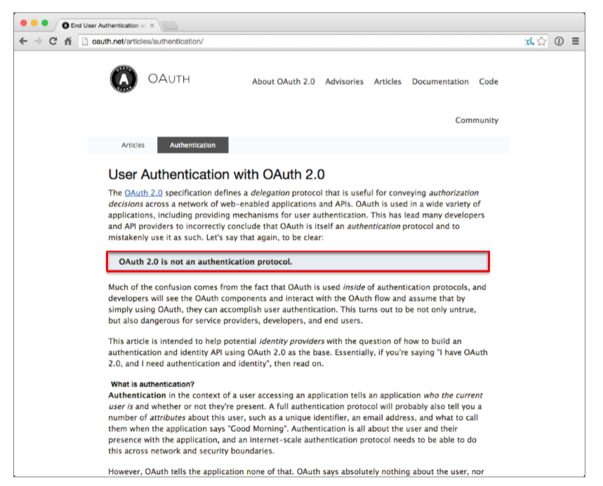
What’s wrong with OAuth 2.0?

Slide 20
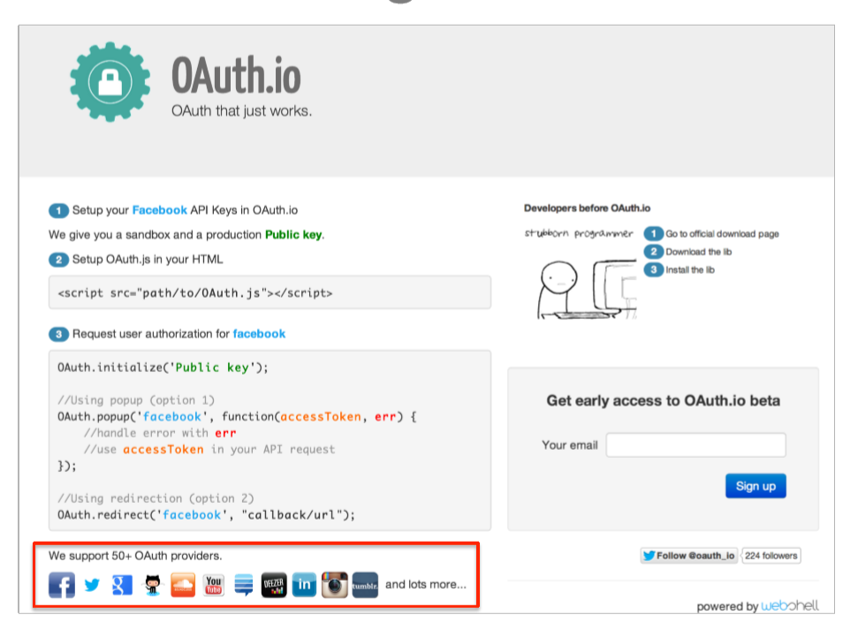
What’s wrong with OAuth 2.0?

Slide 21
Open ID Connect
The Basics
Notes:
Raster verplaatsen Bovenop het fotovak staat een raster, dat je naar wens mag verplaatsen, zodat het gat goed uitkomt op de foto. Klik 1 keer op het raster, verplaats het dan met de pijltjes toetsen.

Slide 22
Open ID Connect (OIDC)
Authentication protocol on top of OAuth2
Deﬁnes identity tokens
Deﬁnes standard token type
Deﬁnes standard cryptography
Deﬁnes validation procedures
Deﬁnes standard scopes
Combines authentication with short/long-­lived delegated API access
Deﬁnes ﬂows for native, browser and server-­based applications

Slide 23
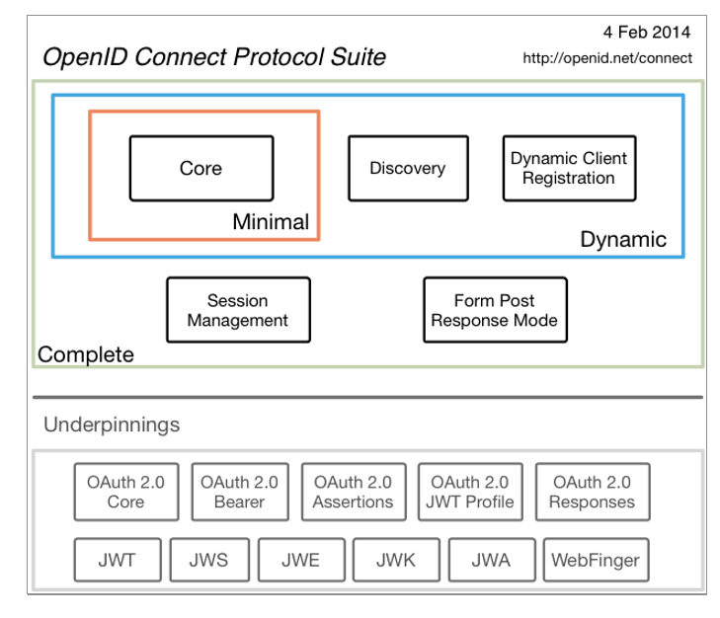
Open ID Connect (OIDC)
http://openid.net/connect

Slide 24
OIDC
AUTHORIZATION SERVER
OpenID Connect
Authenticate the user for me?
OAuth 2.0
Help me out here, is this access token valid?
OAuth 2.0
Can I access an API please?
CLIENT
OAuth 2.0
Request with an access token
RESOURCE SERVER API

Slide 25
OAuth 2.0 and OIDC grants
Mechanisms for a client to get credentials from the AS to access a RS
We have different grants because we have different app types
Code
Implicit
RO password
Client Credentials
OIDC adds the following grant
Hybrid
Various independent extensions
Token Exchange
Device Profile
Assertion
…

Slide 26
Client Types
Confidential Clients
Any application type that can prove its own identity to the authorization server
Public Clients
Any application type that CANNOT prove its own identity to the authorization server

Slide 27

AUTHORIZATION SERVER
BACKEND
API
The OAuth 2.0 Client Application

Slide 28
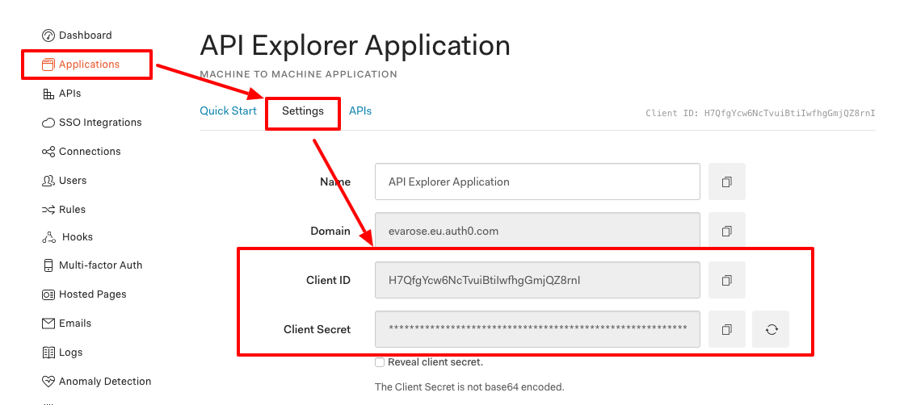
Clients are registered with the authorization server with an ID and a credential (secret, public key, …)

Slide 29
Scenario’s that do not involve user-based access rely on the Client Credentials grant
AUTHORIZATION SERVER
Request access token
with client authentication
1
2
Access token
3
Request with access token
4
Response
BACKEND
API
The OAuth 2.0 Client Application

Slide 30
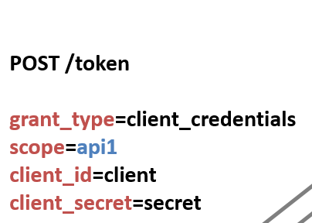
CLIENT CREDENTIALS Grant
Indicates the client credentials flow
The API we want to access
The client exchanging the code
The client needs to authenticate

Slide 31
Client credentials grant
The client credentials grant supports machine-to-machine access
The grant relies on client credentials which have to be kept in a secure location (i.e., not hardcoded in user apps)

Slide 32
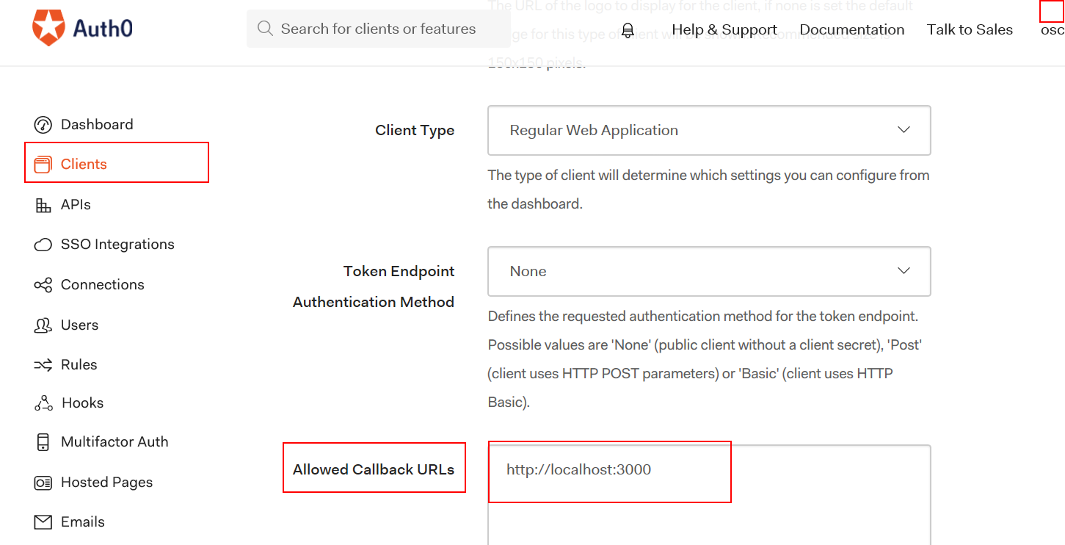
The redirect URI restricts how the authorization server can send data through the browser to the client, preventing an attacker from hijacking valuable resources

Slide 33
Handle user authentication / consent
4
USER
AUTHORIZATION SERVER
Follow the redirect
3
Exchange authorization code with client authentication
7
8
Access token & refresh token
5
Redirect to browser with authorization code
1
Connect to my account
9
Request with access token
2
Initialize the flow with a redirect
10
Response
BROWSER
6
Redirect with authorization code
BACKEND
API

Slide 34
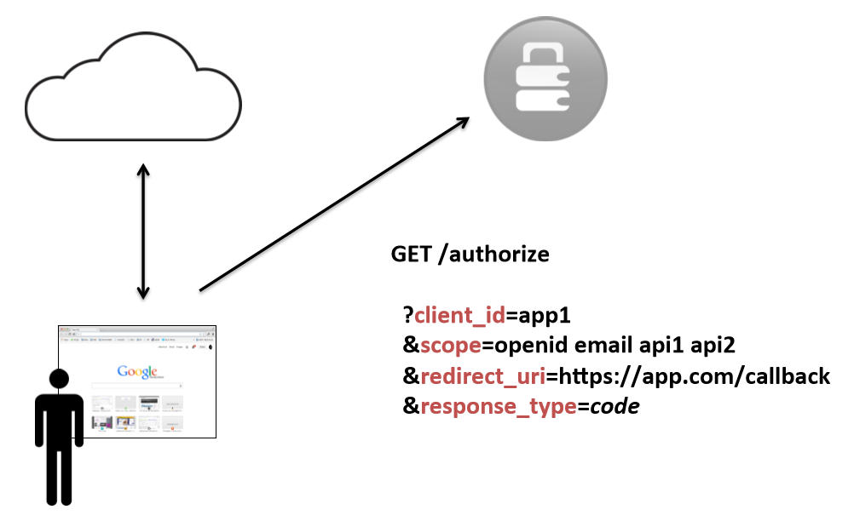
Authorization Code Flow Long lived API Access

Slide 35
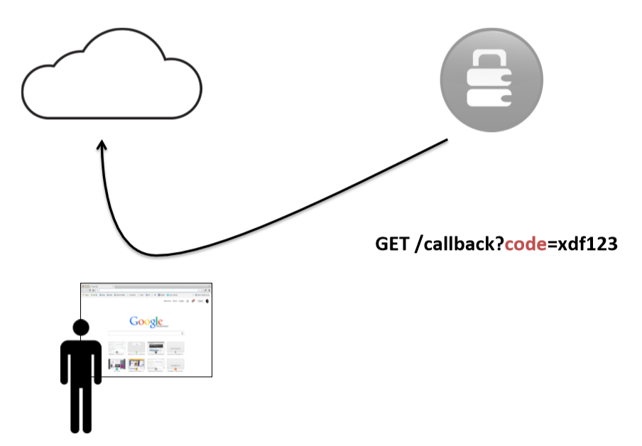
Authorization Code Flow response

Slide 36
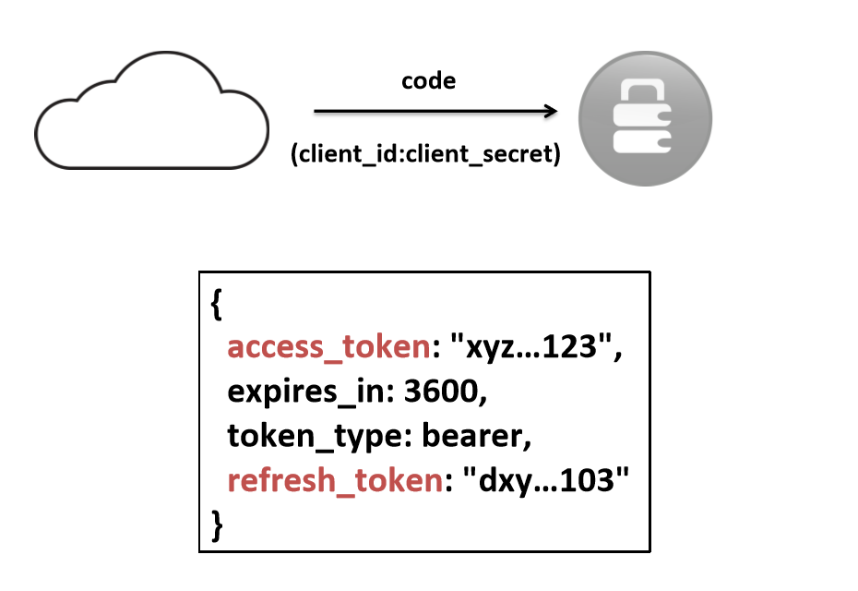
Back channel communication
Notes:
Code is exchanged for access token, id token and refresh token

Slide 37
Oauth 2.1
Changes in OAuth 2.1
Notes:
Raster verplaatsen Bovenop het fotovak staat een raster, dat je naar wens mag verplaatsen, zodat het gat goed uitkomt op de foto. Klik 1 keer op het raster, verplaats het dan met de pijltjes toetsen.

Slide 38
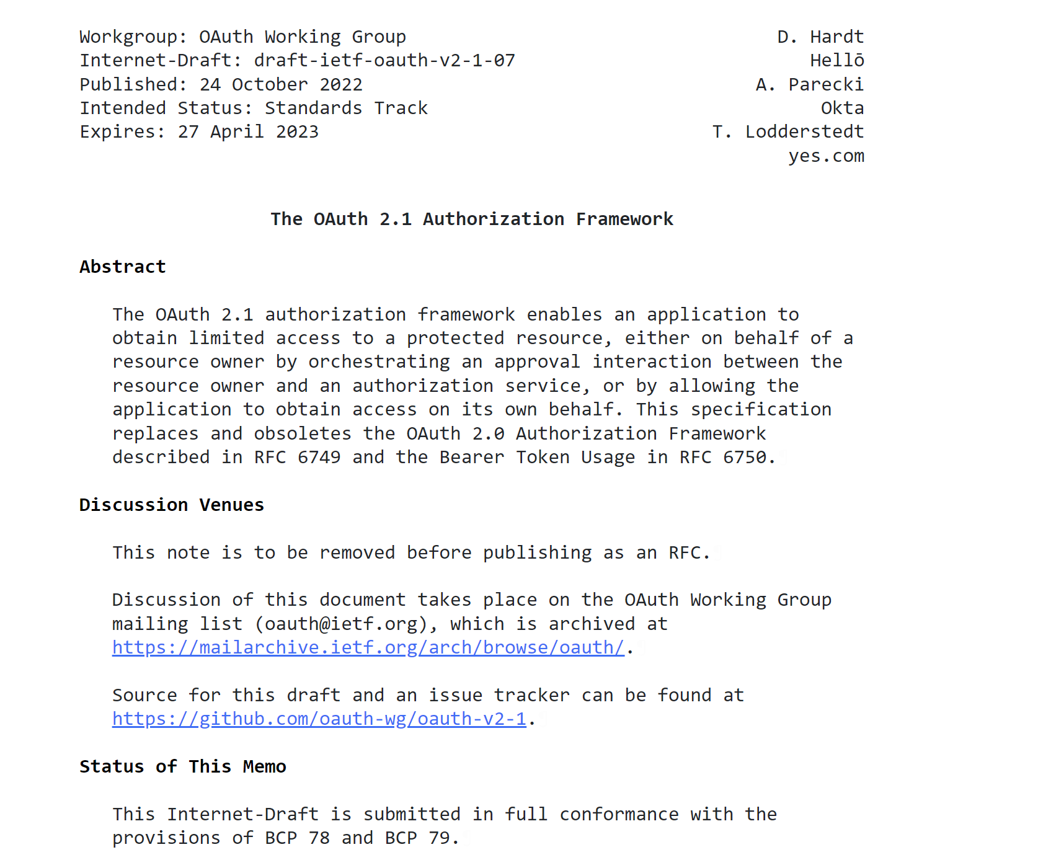

Slide 39
OAuth 2.1 explicitly forbids wildcards and partial redirect URI matching. Only exact matches are allowed.
The redirect URI restricts how the authorization server can send data through the browser to the client, preventing an attacker from hijacking valuable resources

Slide 40

Authorization Code Grant with PKCE
Oauth 2.1 FLOWS

Slide 41
Handle user authentication / consent
7
Store the code challenge along with the authorization code
6
11
Recalculate the hash of the code verifier and compare to the stored code challenge
USER
AUTHORIZATION SERVER
Redirect with the code challenge in the URL
5
Exchange authorization code with client credentials and the code verifier
10
12
Access token & refresh token
8
Redirect to backend with authorization code
1
Connect to my account
13
Request with access token
4
Initialize the flow using the code challenge
14
Response
BROWSER
9
Redirect with authorization code
BACKEND
API
Calculate the SHA256 of the code verifier (code challenge)
3
2
Generate a random value (code verifier) and associate with user’s browser (e.g. cookie)

Slide 42
Authorization code grant with pkce
The authorization code grant with PKCE allows the user to delegate authority to an application to access APIs on their behalf

Slide 43
Authorization code grant with pkce
What about frontend applications?

Slide 44
Handle user authentication / consent
7
Store the code challenge along with the authorization code
6
11
Recalculate the hash of the code verifier and compare to the stored code challenge
USER
AUTHORIZATION SERVER
12
Access token & refresh token
Redirect with the code challenge in the URL
5
Exchange authorization code with client credentials and the code verifier
10
There is no client authentication so all security relies on the attacker not controlling the client redirect URI
8
Redirect to backend with authorization code
1
Connect to my account
13
Request with access token
4
Initialize the flow using the code challenge
14
Response
BROWSER
9
Redirect with authorization code
FRONTEND
API
Calculate the SHA256 of the code verifier (code challenge)
3
2
Generate a random value (code verifier) and associate with user’s browser (e.g. cookie)

Slide 45
FRONTEND WEB APPS CAN ALSO USE THE AUTHORIZATION CODE FLOW with pkce
The authorization code grant with PKCE allows the user to delegate authority to an application to access APIs on their behalf

Slide 46
Handle user authentication / consent
7
Store the code challenge along with the authorization code
6
11
Recalculate the hash of the code verifier and compare to the stored code challenge
USER
AUTHORIZATION SERVER
12
Access token & refresh token
Redirect with the code challenge in the URL
5
Exchange authorization code with client credentials and the code verifier
10
There is no client authentication so all security relies on the attacker not controlling the client redirect URI
8
Redirect to backend with authorization code
1
Connect to my account
13
Request with access token
4
Initialize the flow using the code challenge
14
Response
BROWSER
9
Redirect with authorization code
MOBILE
API
Calculate the SHA256 of the code verifier (code challenge)
3
2
Generate a random value (code verifier) and associate with user’s browser (e.g. cookie)

Slide 47
MOBILE APPS CAN ALSO USE THE AUTHORIZATION CODE FLOW with pkce
WHEN USING THE SYSTEM BROWSER
The embedded system browser provides session support(SSO) and advanced MFA, but also protects the user’s credentials.
Do NOT capture credentials within the app.

Slide 48
Oauth 2.1 FLOWS
Overview
Authorization Code Grant
Implicit Grant
Resource Owner Password Credentials Grant
Client Credentials Grant
Refresh Token Flow
Requires PKCE in 2.1
Deprecated
Deprecated
Preserved in 2.1
Modified in 2.1

Slide 49
Refresh Token Flow
Oauth 2.1 FLOWS

Slide 50
Oauth 2.1 FLOWS
Refresh Token Flow
AUTHORIZATION SERVER
Refresh tokens enable short-lived access tokens (e.g., 5 – 10 min)
2
Request new access token with refresh token
3
Access token & refresh token
When used in a frontend application, there is no client authentication, so refresh tokens are effectively bearer tokens
4
Request with access token
The specification require the use of refresh token rotation for bearer refresh tokens
5
Response
FRONTEND
API
Frontend has an access token and refresh token, and monitors access token expiration
1
50

Slide 51
Refresh Token FLOW
Refresh Token Rotation
AT1 expires
AT2 expires
AT3 expires
App obtains tokens
AT1 and RT1
App refreshes tokens
Use RT1 Receive AT2 and RT2
App refreshes tokens
Use RT2 Receive AT3 and RT3
App refreshes tokens
Use RT3 Receive AT4 and RT4

Slide 52
Refresh Token FLOW
Authorization server notices reuse of RT2
No tokens are issued RT3 is revoked
Detecting Refresh Token Abuse
Attacker steals RT2
Attacker uses RT2
Receive AT3 and RT3
AT1 expires
AT2 expires
App obtains tokens
AT1 and RT1
App refreshes tokens
Use RT1 Receive AT2 and RT2
App refreshes tokens
Use RT2

Slide 53
Refresh tokens must be one-time use or sender-constrained
Sender-constrained refresh tokens require credentials or a secret to use, making them more secure.
Bearer refresh tokens can only be used once, so they require refresh token rotation.

Slide 54

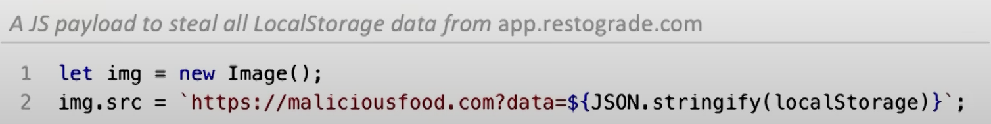
Refresh Token FLOW
The common perception of malicious Javascript
1
Execute malicious JS code (e.g. XSS)
2
Steal data from local storage
1
3
Send data to a server controlled by the attacker
4
Abuse the stolen data (access token, refresh token)
2
Short-lived access tokens reduce the impact of stol access tokens
3
Refresh token rotation prevents re-use of stolen refresh tokens
ATTACKER
4
AUTHORIZATION SERVER

Slide 55
SCRIPT KIDDIES ARE NOT YOUR MAIN THREAT

Slide 56
Refresh Token FLOW
Sidestepping the protection of refresh token rotation
1
Execute malicious JS code (e.g. XSS)
2
Set up a heartbeat that sends a request every 10s
1
3
Steal refresh tokens from the application
4
Send latest refresh token to the attacker’s server
3
5
Detect that the heartbeat has died (wait until the user is offline)
6
Abuse stolen refresh token until chain expires
2
4
ATTACKER
6
AUTHORIZATION SERVER
5

Slide 57
THE ATTACKER CONTROLS THE FRONTEND APPLICATION
They can do anything the legitimate app can do!

Slide 58
Refresh Token FLOW
Requesting a fresh set of tokens
1
Execute malicious JS code (e.g. XSS)
2
Start a silent flow with hidden iframe
1
3
Request authorization code with existing session (through cookie)
4
Send authorization code to the attacker’s server
2
5
Exchange the code for a new set of tokens
3
The legitimate application either resumes an existing session with a silent flow in an iframe, or it asks the user to login to establish a new session. The security of this flow relies on only sending the authorization code to the pre-registered redirect URI.
4
ATTACKER
5
AUTHORIZATION SERVER

Slide 59


Slide 60
BFF concept
Backend-For-Frontend
Notes:
Raster verplaatsen Bovenop het fotovak staat een raster, dat je naar wens mag verplaatsen, zodat het gat goed uitkomt op de foto. Klik 1 keer op het raster, verplaats het dan met de pijltjes toetsen.

Slide 61
Backend-for-frontend
The Concept
Run the Authorization Code flow with client authentication
AUTHORIZATION SERVER
1
THE “FRONTEND” APPLICATION
Issue access token and refresh token
2
Track state with cookies
FRONTEND
BFF
3
Proxy API requests with access token retrieved from cookie
The OAuth 2.0 client application
The BFF does not contain any business logic. All it does is accept requests with a cookie and forward them to the API with an access token.
A BFF never exposes tokens, but XSS in the frontend still allows the attacker to send requests via the BFF
RESOURCE SERVER API
BFF client can follow best practices for backend applications (strong client authentication, sender constrained tokens,…

Slide 62
BACKEND-FOR-FRONTEND
Relies on core building blocks of web apps(cookies, backend OAuth 2.0 flows
BFFs can be stateful or stateless.

Slide 63
DEMO
Backend-for-frontend
Notes:
Raster verplaatsen Bovenop het fotovak staat een raster, dat je naar wens mag verplaatsen, zodat het gat goed uitkomt op de foto. Klik 1 keer op het raster, verplaats het dan met de pijltjes toetsen.

Slide 64
TAKEAWAYS
Notes:
Raster verplaatsen Bovenop het fotovak staat een raster, dat je naar wens mag verplaatsen, zodat het gat goed uitkomt op de foto. Klik 1 keer op het raster, verplaats het dan met de pijltjes toetsen.

Slide 65
Takeaways
If you are using OAuth 2.0 the right way, you are using OAuth 2.1
User Apps typically use the Authorization Code Flow with PKCE
Security-sensitive frontend applications should use a BFF

Slide 66
Bart WULLEMS
Business area director

